Slide 1
Rules for the 2024 Race
William Shih, Deputy Race Director

Slide 2
EVENT UPDATES
The Rules are periodically clarified or amended to meet the needs of the specific race.
Rule 29 requires solar car teams to make periodic reviews of these updates to stay up-to-date.
  Rules updated per Event Update 2024-1

Slide 3
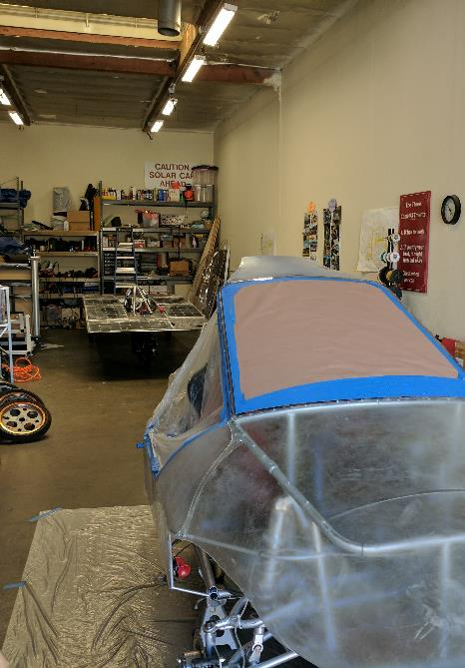
Rules Overview
Do:
  Keep copies of rules throughout workshop
  Following engineering lifecycle: requirements, design, implementation, verification
Don’t:
  Just read once or all in one sitting
  Look at another car’s design and assume it complies with rules (grandfather; waivers)
Changes from 2022 rules noted in Blue
  No changes made between 2023-2024 (other than via Event Updates)

Slide 4
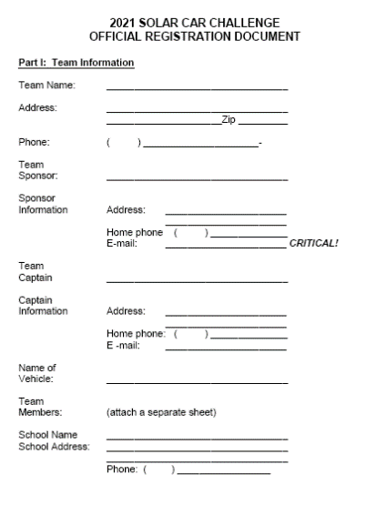
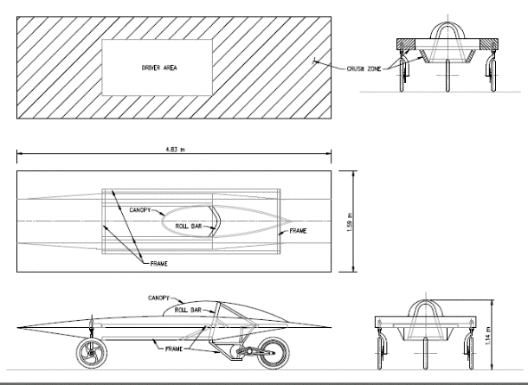
Registration
Sections 1 – 3: Purpose, Administration, Entries and Registrations
Registration Documents and Registration Fee requirement March 1st:
(1) Detailed CAD drawings showing mechanical structure, including “crush zones.” Crush zones must be clearly labeled. Location of major components and notional driver must be shown.
(2) Detailed schematic / wiring diagram showing electrical system.
(3) Digital team photo [emailed]
(4) Manufacturer’s data sheets for batteries showing type & capacity
(5) Manufacturer’s data sheets for solar array, including list price
(6) Manufacturer’s data sheets for motor and motor controller
(7) Manufacturer’s data sheets for array and battery cutoff switches
(8) Manufacturer’s data sheets for main fuses
(9) Manufacturer’s data sheets for wheels and brakes
(10) Manufacturer’s data sheets for suspension and steering
Digital and hard copies required by March 1st.

Slide 5
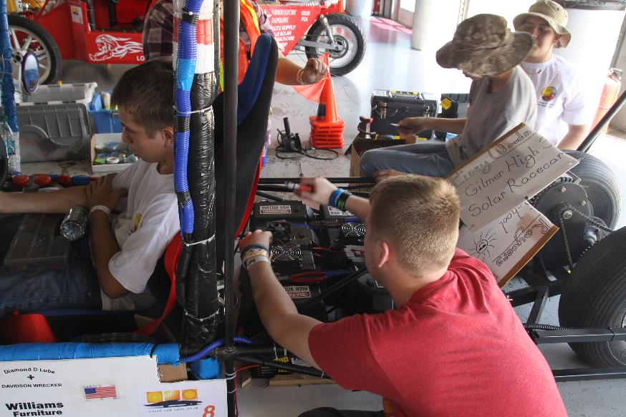
Rule 3.8 – Design of Solar Car
It is the intent of the event that the solar cars be designed and constructed by high school students on the solar car team.
No portion of another vehicle’s frame may be reused in a solar car unless the team re-engineers/ modifies the frame to fit the team’s solar car design or to install separate off-the-shelf components.

Slide 6
Rule 3.9 - Scrapbook
Scrapbook must be shown to Check-In to Race.
Scrapbook must show history of the team building the solar car, including team engineering decision-making.
Scrapbook will show team photos, design & planning, CAD drawings, fundraising, testing.
Digital copy of scrapbook due June 1st.

Slide 7
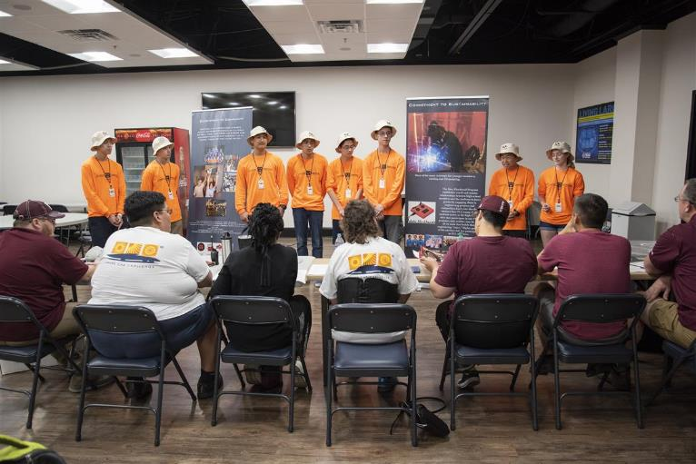
Rule 3.10 – Oral Presentations
Up to 20 laps not available for oral presentations.
Presentation show discuss the teams overall planning, including engineering decisions.
Teams have a strict 8 minutes to give their presentation.
Judges will now give feedback per Oral Presentation Guidelines

Slide 8
Rule 3.5 – Qualifier
Qualifier for the 2021 Race will include:
  3-Day Scrutineering
  Stage One – First Day of Racing
The top teams in each Solar Car Challenge Racing Division will move on to the three-day Stage Two of racing. [Approximately 25 teams]
  The winner in each division will be the team that accumulates the most laps in Stage 1 and 2.
  All teams will receive an Official Race Ranking

Slide 9
Section 10: DIVISIONS
Classic Division: No hub motors; lead-acid or LiFePO4 batteries; solar modules or cells at ≤ 22% efficient
Advanced Classic Division: Classic Division cars with 3 or more years experience in Solar Car Challenge
Advanced Division: Hub motors; prefabricated solar car molds; advanced battery chemistries
Electric-Solar Powered Car Division: Solar cells on charging station; Classic Division technology; 2 x 2.625 kWh battery packs
Cruiser Division: Seating for four; totally enclosed; solar array integrated into the skin of the vehicle; workable trunk

Slide 10
Minor Updates
Rule 5.4.2(d) (Fuse Location): Is not required to be within 15cm of battery pack
Rule 5.10 (Braking): Must use automotive style foot brake pedals
Rule 6.7 (Driving): Minimum speed for cross-country course is 20 mph (no minimum on track)
Rule 7.8 (Safety Equipment): At least one fire extinguisher must have 10 lb capacity
Rule 15.2 (Battery Replacement): Replacement penalty up to the number of miles driven on the day of replacement
Rule 32.2.8 (Trunk): Electric-Solar Powered Cars must have externally accessible trunk (similar to Cruiser)
Rule 33.3 (Battery Capacity): Cruiser Division allowed to have 10kWh capacity

Slide 11
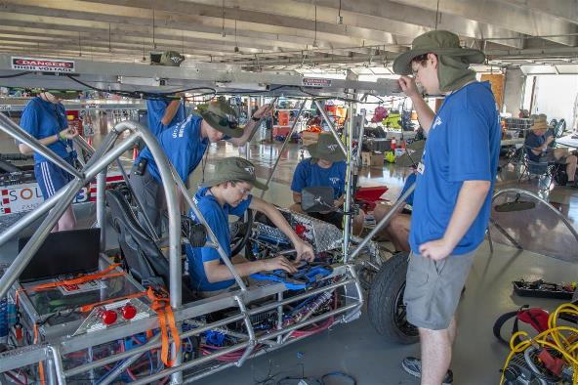
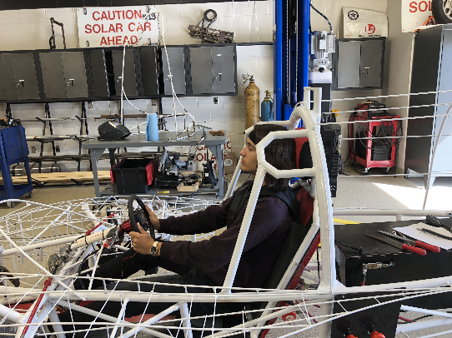
Rule 5.2.x –
Safety Cell, Crush Zone, Roll Bar
Safety Cell– rigid protection encompassing entire driver; minimum OD of 1.9cm; minimum 5cm clearance to driver
Crush Zone – structural components designed to collapse on impact; minimum 15cm clearance to driver; minimum coverage
Roll Bar – protects driver in event of rollover; continuous piece of metal; minimum 5cm vertical clearance; minimum OD of 5cm; minimum wall thickness based on material; welded to frame

Slide 12
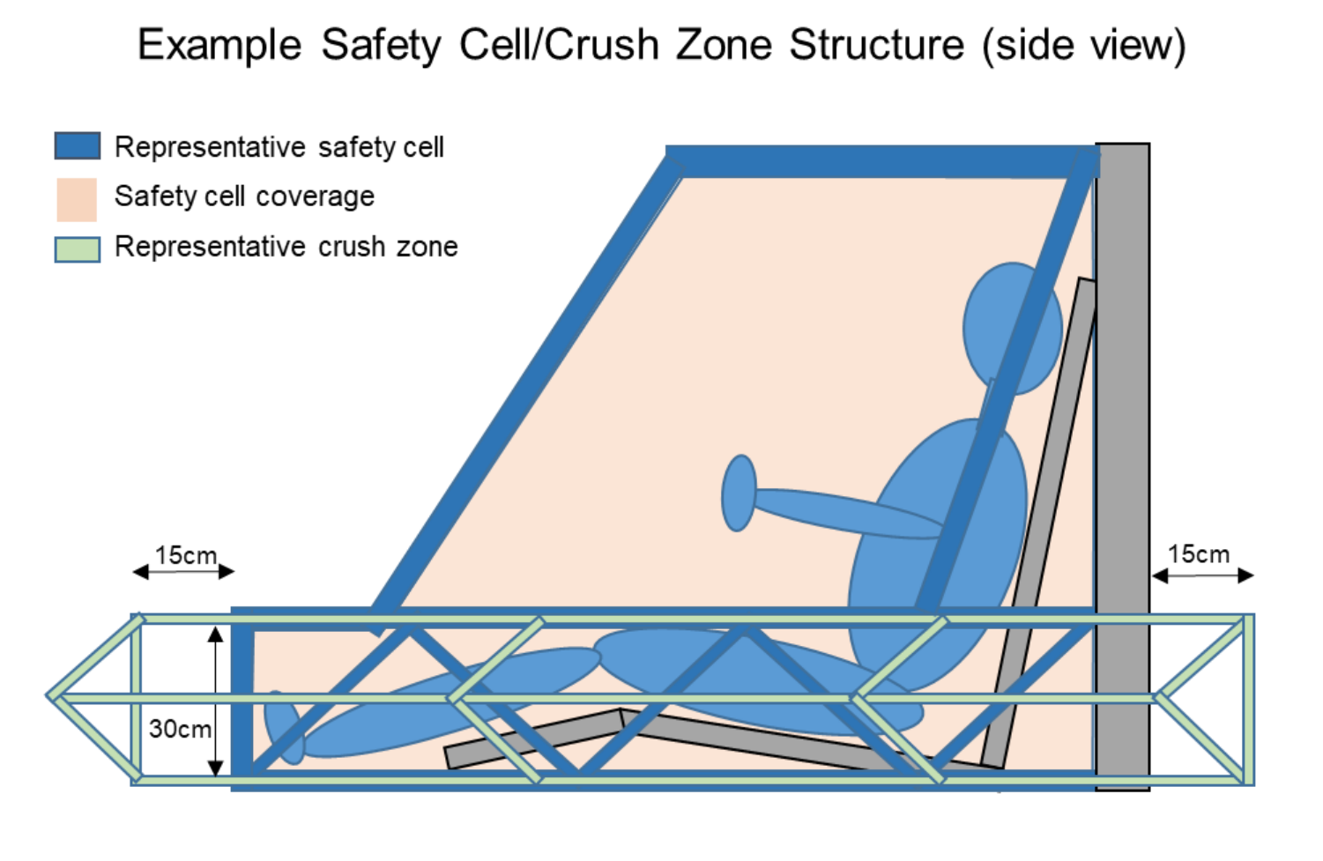
Safety Cell / Crush Zone Details
Both Safety Cell and Crush Zone must encompass the entire driver
Crush zone are structural components designed to collapse on impact
Safety Cell structure protects driver in event of collision; should not deform
Requires padding to protect driver
Crush zones must protect both driver AND battery pack

Slide 13
Section 5.4/5.7 – Electrical
Rule 5.4 (Battery): 5.25 kWh max at 20 hr discharge rate; terminals must have locking washers (see 5.7.3 below).
  For Lithium-based chemistries, use nominal (1C) capacity
Rule 5.4.2 (Main Fuse): 125% of expected peak current, separate enclosure; rated as appropriate for DC voltage
Rule 5.4.3 (Enclosures): Rigid, must have forced-air ventilation; no venting into driver’s compartment; cannot be located at front of vehicle
  No forced air ventilation required for LiFePO4
  Battery boxes cannot be located in front of driver (Event Update 2023-5)
Rule 5.7.1 (Wire): No HV wiring in driver’s compartment
Rule 5.7.3 (Connections): Connections conducting > 36V must be secured by locking washer

Slide 14
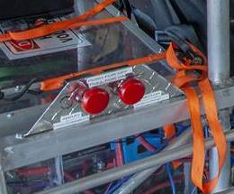
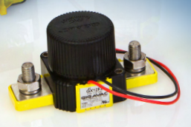
Rule 5.4.5 – Disconnect Switches
Two sets of two switches required
  Motor Disconnect / Array Disconnect
  Internal (“Driver”), External
Relay/contactor must interrupt full load current at system voltage
Switch operates control signal of relay/contactor
  Can be either “push-pull” or “push-rotate”
No high voltage wiring in driver compartment!

Slide 15
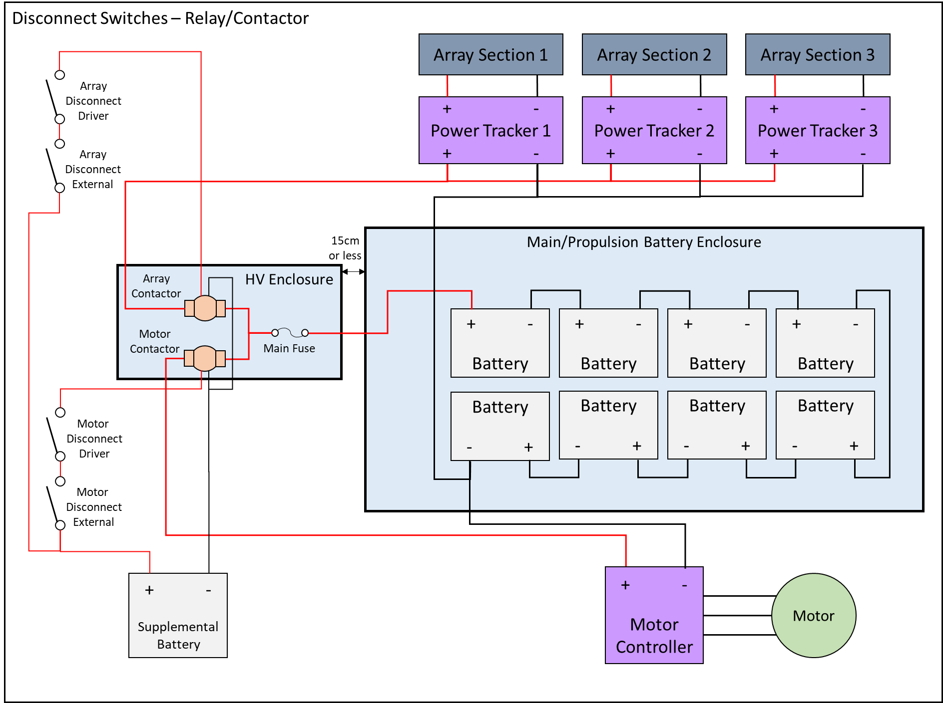
Relay/Contactor Circuit
Control Switches
Relay/ contactor

Slide 16
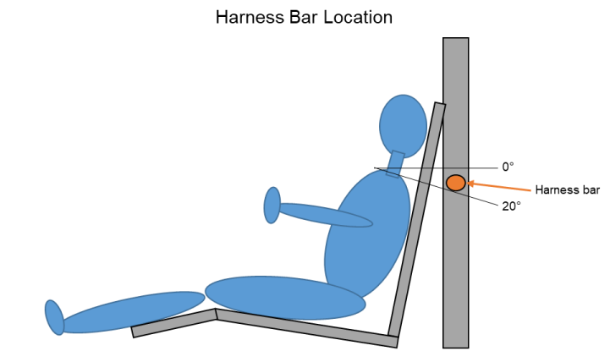

Rule 5.13 – Driver Safety
(a) Safety Belt must be 5 point lap/shoulder harness; attached to structural member per manufacturer’s instructions.
  Requires mounting shoulder belts vertically lower than driver’s shoulder
(b) Cars with body shells must have shells attached to each other
(d) Windshield must protect entire head
(e) Cars equipped with appropriate fire extinguisher for battery chemistry
(j) Seat back braces required for seats on adjustable rails
Seat back brace

Slide 17
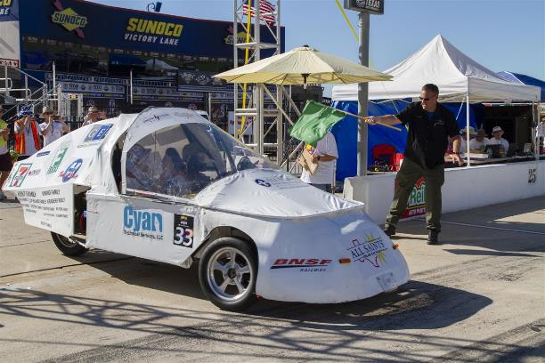
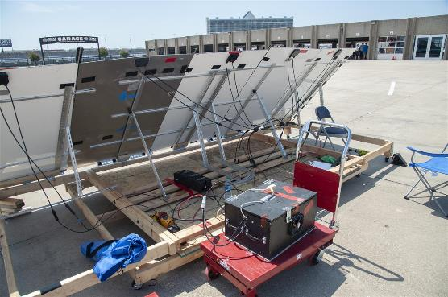
Section 32 – Electric-Solar Powered Car
Simulates a “real world” solar application
  Two passenger vehicle
  Charging Station simulates permanent facility used to charge vehicle
Same rules as Classic Division, with exceptions
Rule 32.2.3a (Configuration): Passengers must be seated side-by-side
Rule 32.2.6 (Battery): Two battery boxes, each with maximum 2kWh capacity; safe battery exchange procedure
Rule 32.2.7 (Disconnects): Solar Car must have two Motor Disconnects; Charging Station must have single Array Disconnect
Rule 32.2.8 (Trunk): Externally accessible storage required
Must provide team member to monitor Charging Station during race hours
  For road race, charging station is mounted on support trailer
Rule 32.7 (Team Assignments): Accomplish one special task each day to demonstrate real-world function

Slide 18
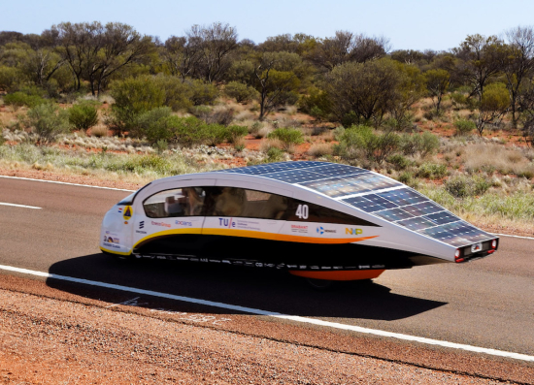
Section 33 – Cruiser Division
Resemble regular passenger vehicle; provides opportunity to strategize based on number of passengers
  Points = # of passengers x distance traveled
Same rules as Advanced Division, with exceptions
Must have four wheels
Must accommodate four passengers; each with immediate access to door for entry/exit (implies 2x2 configuration)
Rule 33.3 – Allows for 10.5 kWh battery capacity
Rule 33.3.5 – Body must be completely enclosed
Rule 33.3.6 – Solar array must be integrated into car body
Rule 33.3.7 – Must have externally accessible storage space

Slide 19
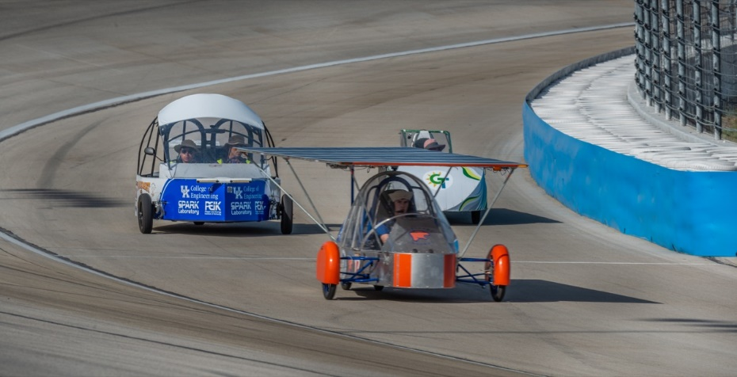
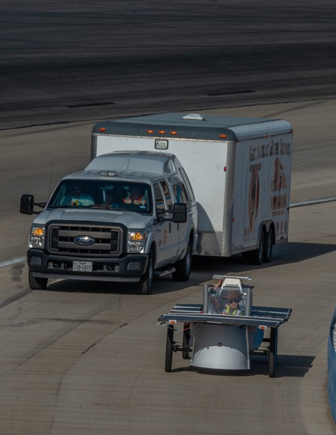
Policies and Procedures for
Closed-Track Races
Addendum to be provided to participants
Drive as close to inside wall, unless passing
Cars must complete pass in reasonable time
Radio Checks/Driver Change Area
Caution Zones
Dedicated Electric-Solar Powered Battery Exchange Area
Spotters

Slide 20
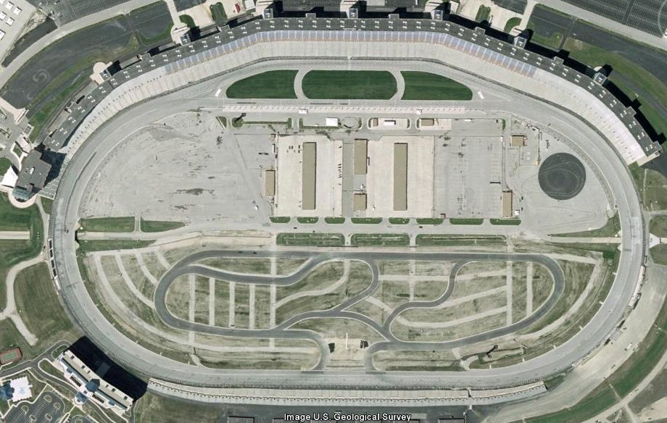
Cut into black triangle unless passing going into Turn 1.
Middle
End
Front Straight
Begin
Begin
End
Vehicles entering Turn 1 from pit lane yields to main traffic.
Turn 1
Stay to inside coming out of Turn 4, stay to right of cones to stay on track
Turn 4
End
No 3 wide passing after first cone. Can use black triangle if desired.
Begin
At end of cones, can resume 3 wide passing
Begin
Must complete 3 wide passing by first cone.
End
Turn 2
Slower cars should drive in apron on back straight
Turn 3
End
Begin
Back Straight
Begin
Middle
End

Slide 21
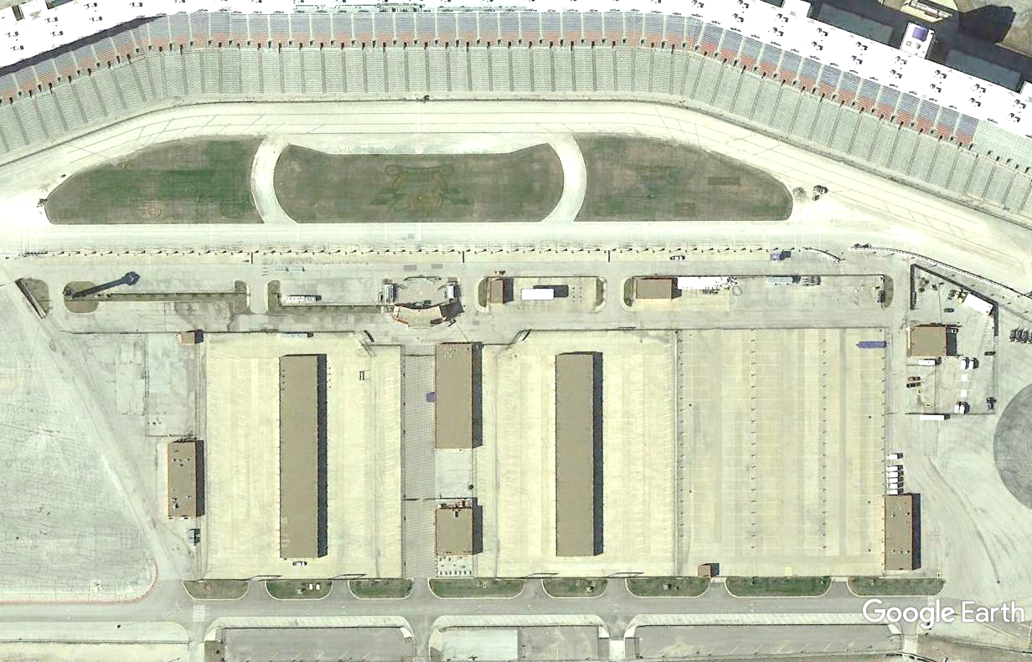


SPOTTERS
PIT LANE
ALT TRACK EXIT
TRACK EXIT
PIT SLOTS
TRACK ENTRY
SUPPORT IN/OUT
OTHER TEAM VEHICLE
PARKING
TMS USE
ONLY
CHARGING STATIONS
MEDIA
CTR
TRAILER PARKING
PRIMARY GARAGE
SUPPORT PARKING
SUPPORT PARKING
TRAILER PARKING
SECONDARY GARAGE
TMS USE
TRANSFER BETWEEN GARAGES

Slide 22
Rules for the 2024 Race
William Shih, Deputy Race Director

